Slide 1
A-EYE: Utilizing Multistage Neural Networks and Landmark Localization for Fundus Image Disease Detection
Thomas Chia
Chantilly High School
Chantilly, Virginia, United States
ISEF Project ID: TMED024
All images/charts/graphics created by finalist unless otherwise referenced.

Slide 2
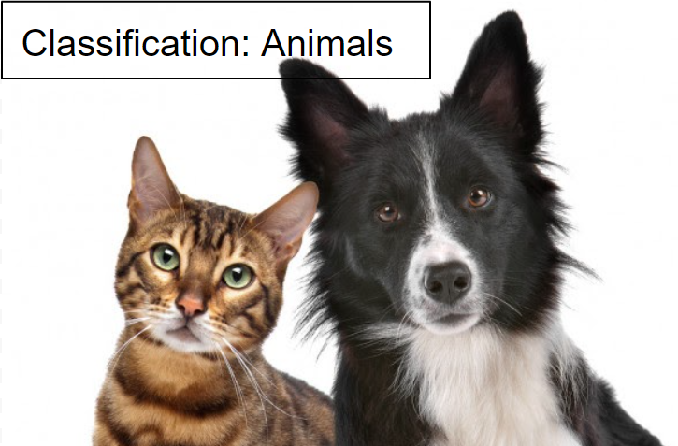
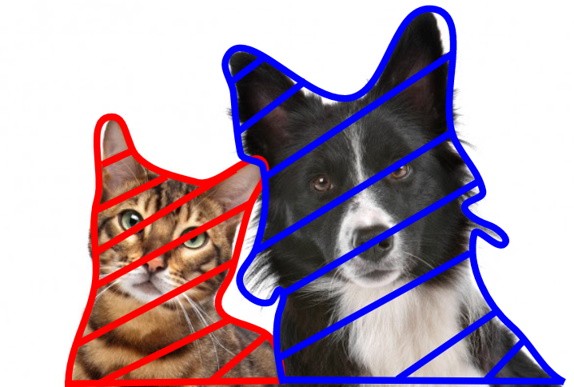
Introduction to Retinal Image Analysis [RIA]
Retinal image analysis uses images of the retina to determine the health of the eye.
Why is automation needed in RIA?
RIA is both resource intensive and time consuming
Requires extensive training for medical professionals
There is a shortage of Ophthalmologists for eye screening (Kawasaki & Grausland, 2019, pg. 8)
How will automoation improve RIA?
Lessen work loads of ophthalmologists
Give patients with conditions a higher priority (triaging)
Low cost, high performance implementation
Example of other methods to automate RIA:
Computational Algorithms – hard coded algorithms
SuperPixel (Cheng et al., 2013)
Ensemble System for MA Detection (Antal et al., 2014)
Deep Learning – dynamically learned algorithms
M-Net with Polar Transformation (Fu et al., 2018)
Visiona (Ramachandran et al., 2018)
Deep learning is a more researched area due to its versitility and ability to generalize to a larger population.
Previous methods of research: Image Classification, Semantic Image Segmentation
Image Classification and Image Segmentation through Deep Convolutional Neural Networks
A-EYE is a new attempt at using A.I. in retinal image analysis
Figure 1
Note. The image on the top displays an example of Image Classifiaction. The image on the bottom displays an example of Image Segmentation.
Picture of the cat and dog was adapted from: https://favpng.com/png_view/paws-claws-dog-cat-relationship-dog-cat-relationship-puppy-pet-png/S7MMPNsb
Classification label and segmentation outlines placed by finalist.

Slide 3
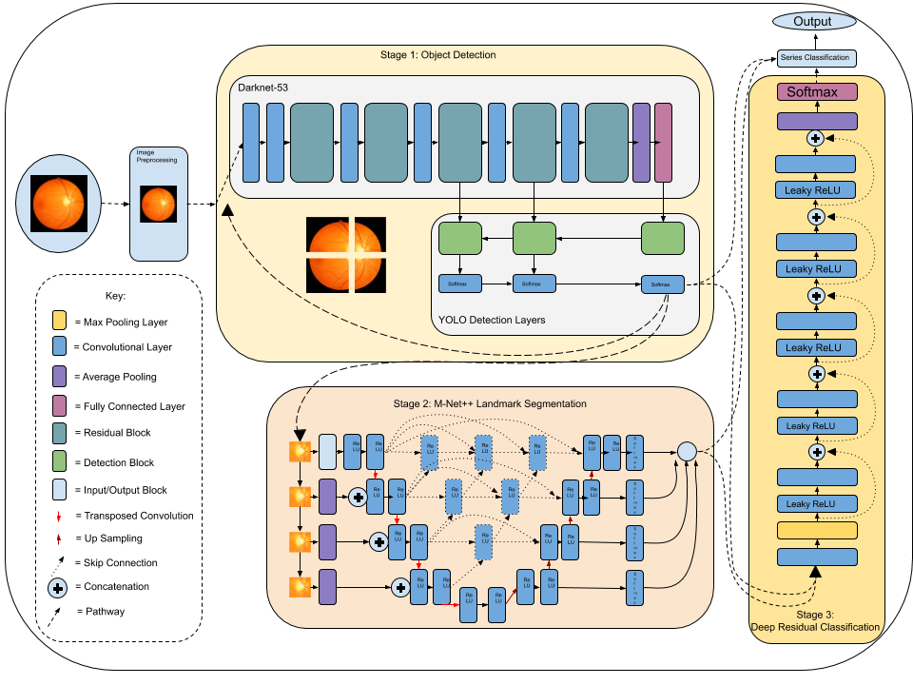
The A-EYE Architecture
A-EYE uses a retinal fundus image to generate its diagnosis.
Composed of 3 stages:
Stage 0: Image Preprocessing
Stage 1: Object Detection + Quadrant Sectioning
Stage 2: Semantic Segmentation of Optic Disc and Optic Cup
Stage 3: Deep Residual Network to Confirm Outputs
A-EYE is the first-ever attempt at using object detection to look for lesions within the eye.
A-EYE‘s unique architecture provides an unique advantage over previous methods.
Object Detection + Semantic Segmentation Provides an increase in performance over Semantic Segmentation
It provides inference similar to Instance Segmentation.
Object Detection provides an uncontextual method of scanning for conditions
It looks for lesions that create the condition instead of looking for the condition
Better generalization to other populations
Specific types of neural networks are used for each situation: object detection for lesion analysis and semantic segmentation for vertical cup to disc ratio.
Figure 2
Note. The full A-EYE architecture is shown. It begins with a single fundus photo and uses 3 stages to create and output diagnosis.
The fundus image in the figure was adapted from: https://www.njvision.net/our-services/fundus-photography/
A-EYE architecture figure created by finalist.

Slide 4
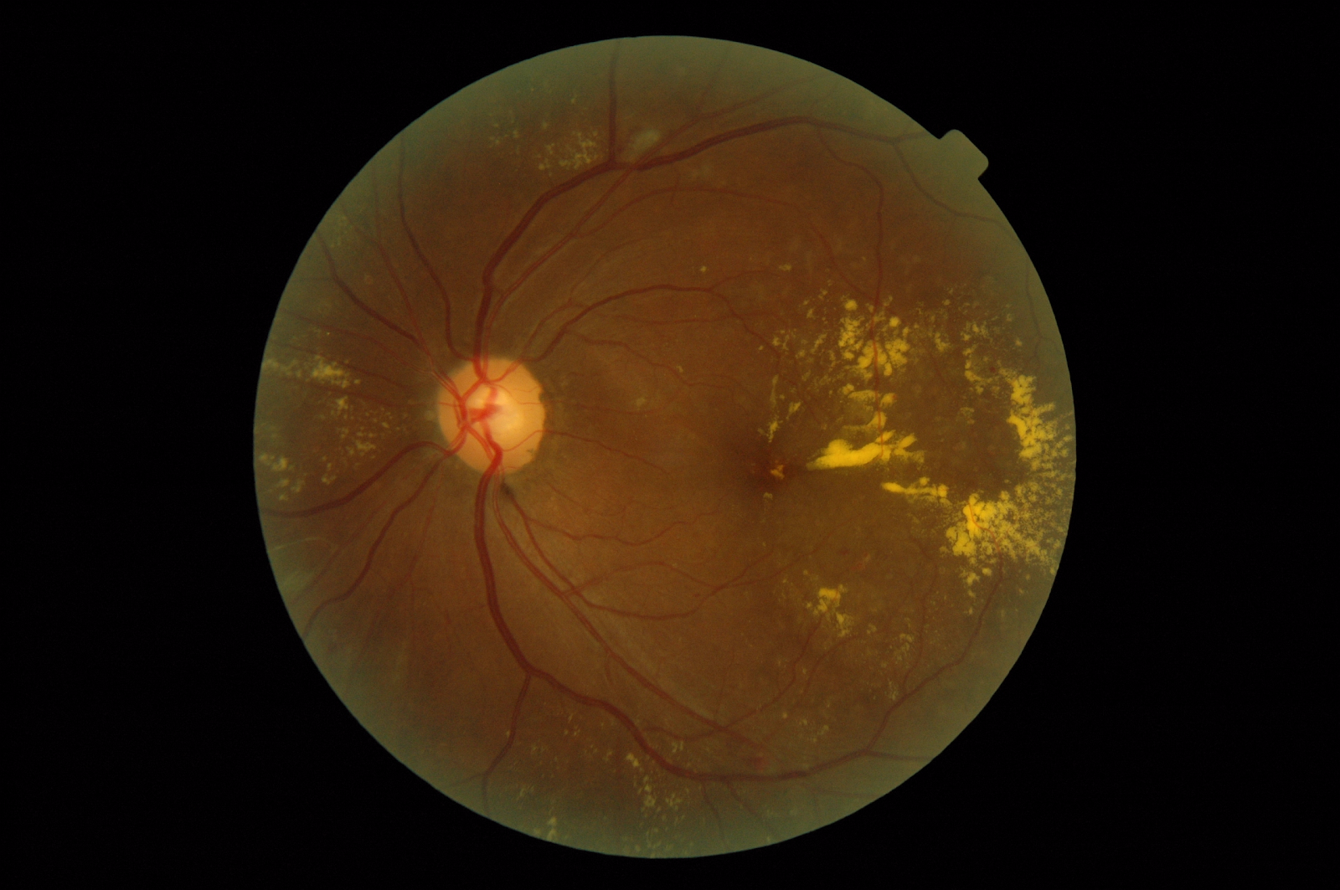
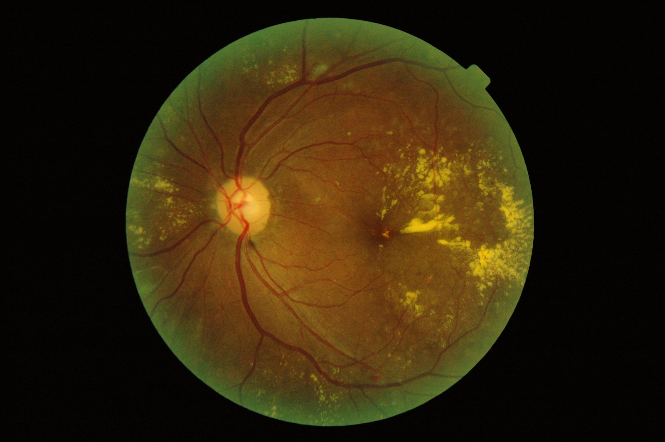
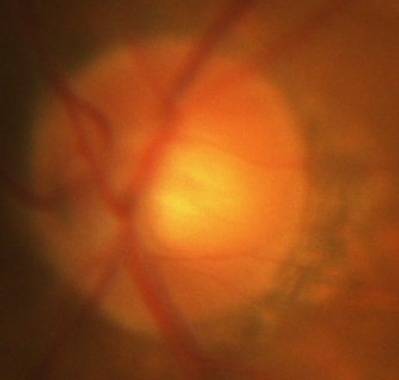
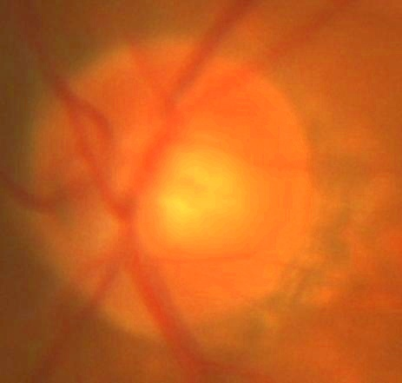
Stage 0: Image Preprocessing
Image preprocessing standardizes and reduces clutter in the image data. It is the prerequisite step in the A-EYE algorithm.
High contrast between lesions
Reduce amount of static and noise
Improve image “brightness“
Processing Methods:
Contrast Limited Adaptive Histogram Equalization [CLAHE]
Hue Saturation Value [HSV] Image Brightening
CLAHE:
Alters image channels within an image to extress certain information
Uses histograms a certain clip limit and area
Fig 3
HSV Image Brigtening
Increase the “V“ aspect of HSV → Increase Brightness
Dynamically increases brightness, bright images recieve little processing, while dark images recieve more
Original Image | Processed Image
Row 1: Fundus Image adapted from the ODIR-2019 Dataset: https://odir2019.grand-challenge.org/
Row 2: Optic Disc Image adapted from the REFUGE Dataset: https://refuge.grand-challenge.org/details/

Slide 5
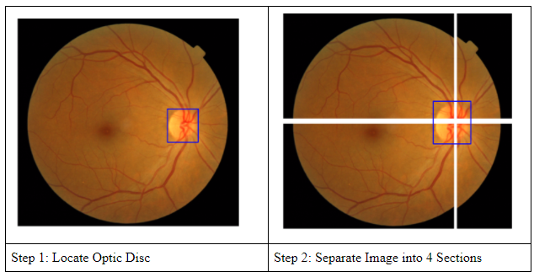
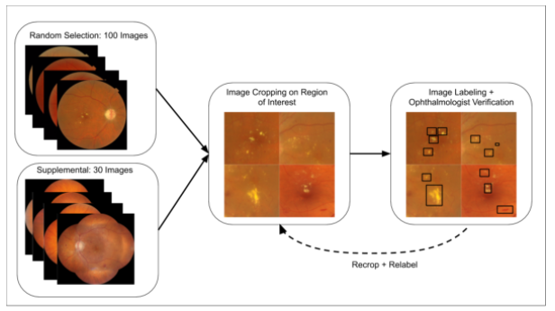
Stage 1: Object Detection
The Object Detection Neural Network:
A Modified You Only Look Once [YOLO] v3 Model
K-Means algorithm for new anchors
More skip connections in a Novelly-Modified Darknet-53
More “low level“ convolutions
Less “high level“ convolutions
By changing the convolutions, the program experiances better performance in small/medium sized objects.
Composed of a “Darknet-53“ backbone with YOLO Detection Layers
Usage of the Object Detection Model:
Detect Landmarks
Quadrant Sectioning
Detect lesions within each quadrant
Novel - Quadrant Sectioning:
A measure against the “small object problem“
Allows for better anchor box refinement
Less information is lost within a convolution
Training Dataset (with Opthalmologist Verification):
Ocular Disease Intelligent Recognition [ODIR-5K] Dataset Used
100 randomly selected images + 30 custom select images.
Recropping into the regions of interest → Total 250 Images
The data was individually hand labeled and verified.
Figure 3: Quadrant Sectioning
Fundus Image Adapted from the MESSIDOR Dataset: https://www.adcis.net/en/third-party/messidor/ ; Optic disc box and quadrant sectioning placed by finalist.
Figure 4: Creation of the Dataset
All Fundus Images adapted from the ODIR-2019 Dataset: https://odir2019.grand-challenge.org/
Boxes and region cropping created by finalist.

Slide 6
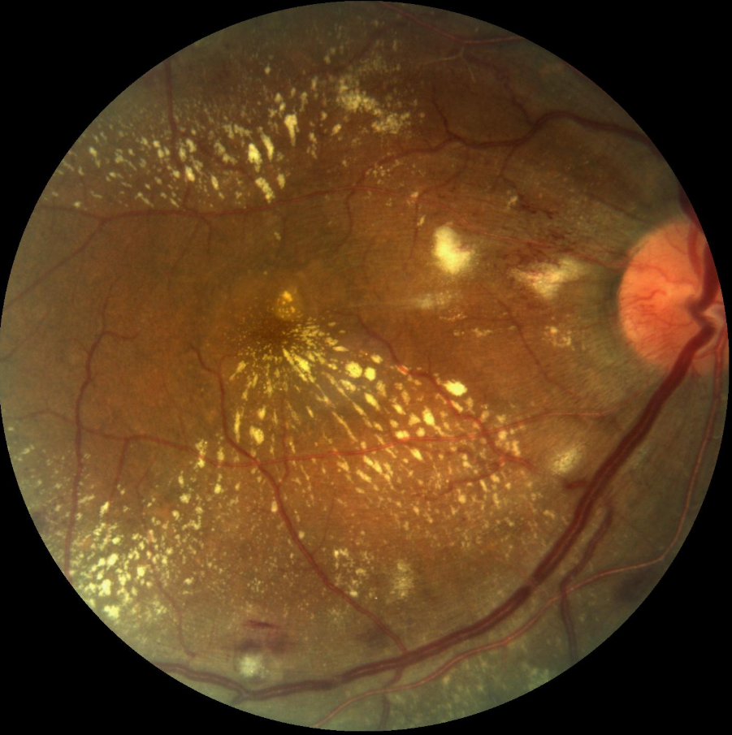
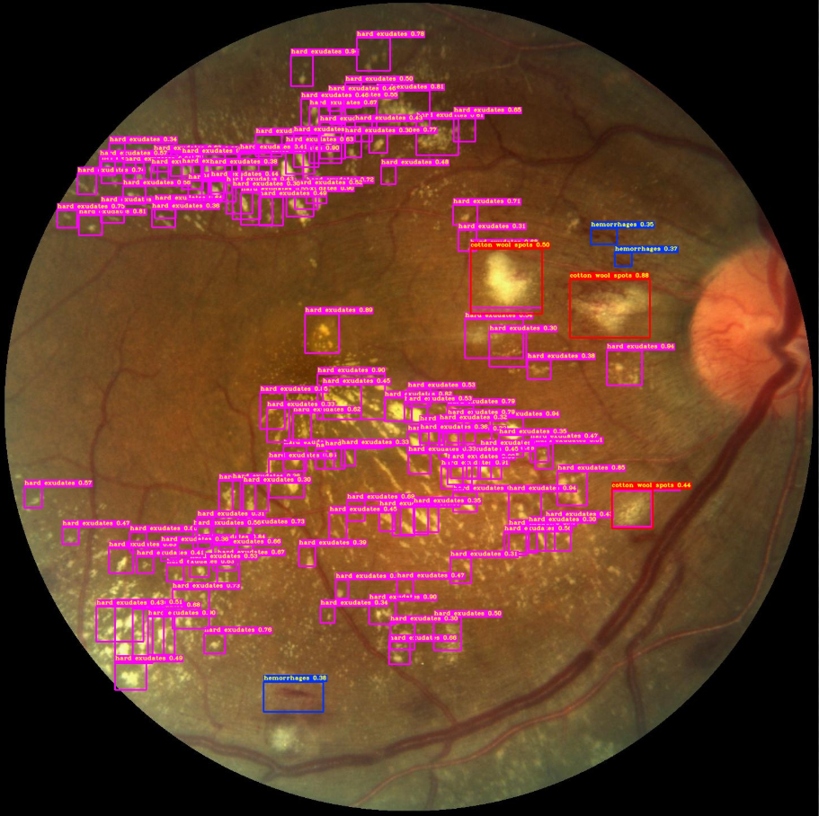
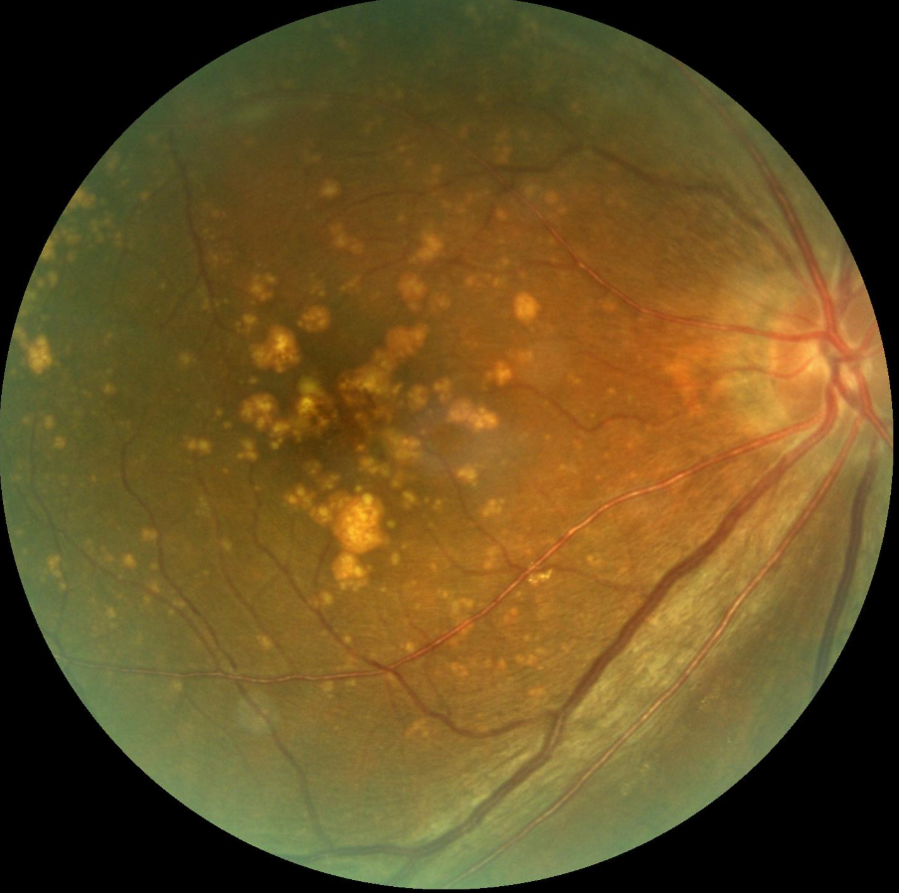
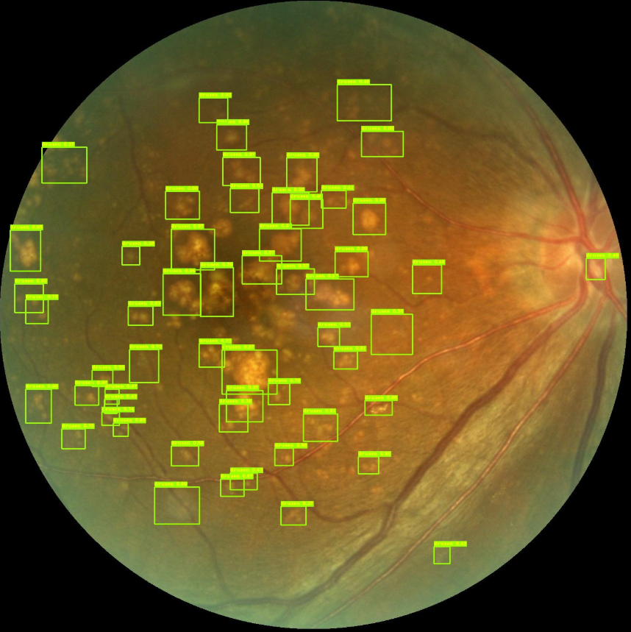
Stage 1: Object Detection Outputs
Detections:
The object detection model can detect:
Microaneurysms [MAs], Hemorrhages, Hard Exudates, Soft Exudates [Cotton Wool Spots], Drusen, Geography Atrophy, and landmarks [Optic Disc + Cup and Macula + Fovea]
The example outputs on the right:
Row 1
Almost all lesions were detected by the model
Only missed a few exudates and hemorrhages
Row 2
Almost all of the drusen were detected
There is a misclassification for one drusen on the optic cup
For these examples, outputs for stage 2 and 3 were suppressed, only displaying the outputs for stage 1.
Figures adapted from the ODIR-2019 Dataset: https://odir2019.grand-challenge.org/
The images in the second column’s bounding boxes were placed by the A-EYE program.

Slide 7
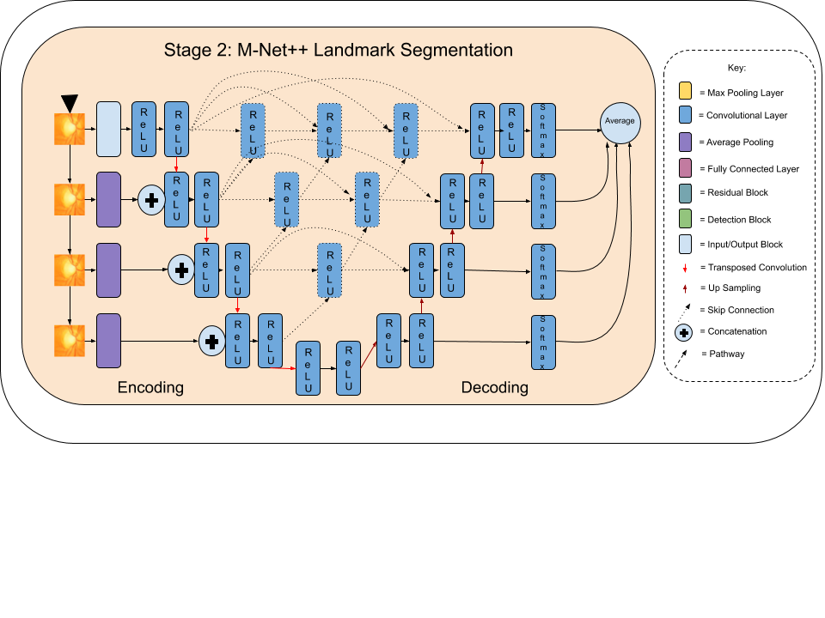
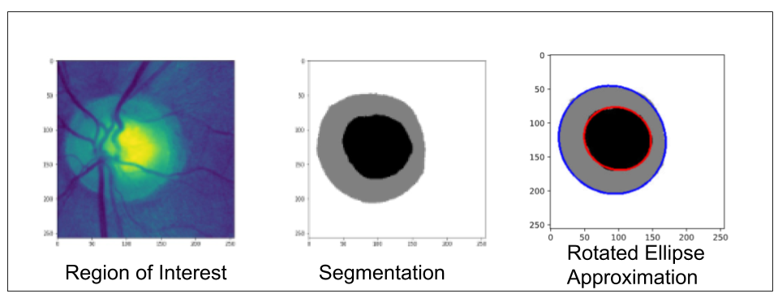
Stage 2: M-Net++ Segmentation Network
The Image Segmentation Network
Uses the novel M-Net++ network
Derived from both the U-Net model and the M-Net model
Increased Skip Connections between encoding and decoding
Upsampling Skip Connections
Averaged Side Outputs
Segmentation Process:
Optic Disc region of interest [ROI] is used (taken from stage 1)
M-Net++ is run on the ROI
A mask is generated from the M-Net++ output
Rotated ellipse is fitted on the masks
Cup to disc ratio is calculated
Training Dataset:
Retinal Fundus Glaucoma Challenge Edition-1 [REFUGE 1] Dataset was used
Image augmentation was used to expand the dataset
Image augmentation increases the amount of data and can improve performance
Vertical flips, horizontal flips, rotations, and stretches were used on each image
Figure 5: M-Net++ Segmentation Model
The Optic Disc image in the figure was adapted from: https://www.njvision.net/our-services/fundus-photography/ ; The architecture model created by the finalist.
Figure 6: Segmentation Process
Optic Disc Image [region of interest] adapted from the REFUGE Dataset: https://refuge.grand-challenge.org/details/; Segmentation and Rotated Ellipse Approximation images created by the finalist.

Slide 8
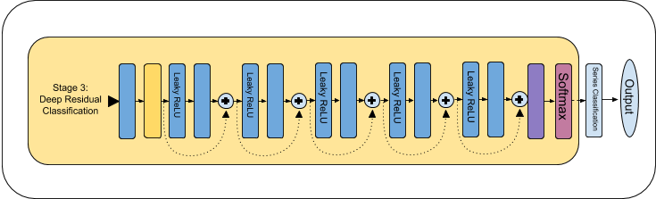
Stage 3:Deep Residual Network
The Deep Residual Network:
Basic sequential model with convolutions and skip connections
Trained on the ODIR-5K network
Data Augmentation (Expansion) was used
Pretrained on ImageNet
Used to ensure the quality of the object detection + image segmentation output.
Figure 5: Deep Residual Network
The Deep Residual Network Model created by the finalist.

Slide 9
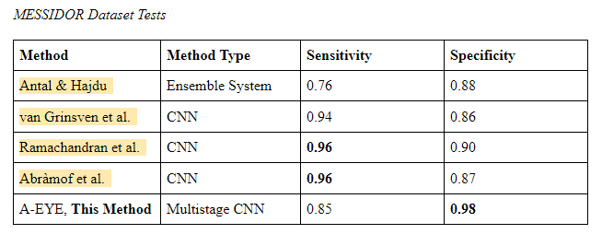
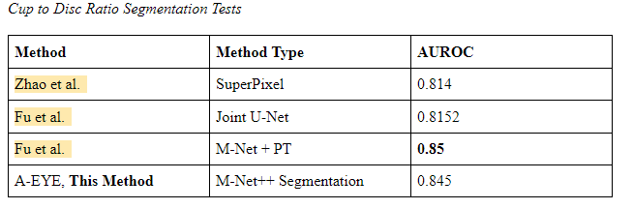
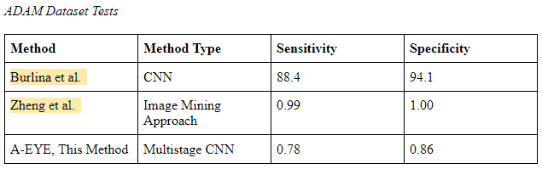
Testing the A-EYE Multiscale Neural Network
Tests on Diabetic Retinopathy Performance:
The Methods to Evaluate Segmentation and Indexing Techniques in the field of Retinal Ophthalmology [MESSIDOR] Dataset was used
Sensitiviy of 0.85
Specificity of 0.98
Tests on Cup to Disc Ratio Calculation + Segmentation:
The Retinal Fundus Glaucoma Challenge Edition-1 [REFUGE 1] TESTING Dataset was used
Area Under the Reciever Operator Curve [AUROC] of 0.845
Tests on Age-Related Macular Degeneration:
The Automatic Detection Challenge on Age-related Macular degeneration dataset [ADAM] was used
Sensitivity of 0.78
Specificity of 0.86
MESSIDOR Sensitivity and Specificity Statistics compiled from: https://doi.org/10.1109/TBME.2012.2193126,
https://doi.org/10.1109/TMI.2016.2526689, https://doi.org/10.1111/ceo.13056, https://doi.org/10.1167/iovs.16-19964
REFUGE [Cup to Disc Ratio Tests] AUROC Statistics compiled from: https://doi.org/10.1117/12.2547992,
https://doi.org/10.1109/TMI.2018.2791488, https://doi.org/10.1109/TMI.2018.2837012
ADAM Sensitivity and Specificity Statistics compiled from: https://amd.grand-challenge.org/
The “A-EYE, This Method” statistics were compiled by the finalist; the tables were created by the finalist.

Slide 10
Conclusion and Importance
Interpreting Test Results:
A-EYE achieves similar or greater results than previous methods
A-EYE is trained on ONLY 250 object detection images on a homogenous dataset [East-Asian]
It generalizes well to other populations, since testing datasets are mainly Western-European Fundus Images
Thus A-EYE makes very good inference to other populations.
A-EYE can be used on a variety of field of views [FOVs] due to its ignorance of landmark locations
A-EYE is a completely new approach to deep learning in RIA.
Employs new techniques: Object Detection + Quadrant Sectioning and M-Net++ Image Segmentation
Looks for lesions to determine condition
Real-time detection due to fast and efficient models [on a Powerful GPU]
Light weight, can be used in edge systems (Raspberry Pi, Nvidia Jetson Nano) and can be accessed through the Internet
Applications of A-EYE and Importance of A-EYE:
A-EYE is not yet a definitive solution to eye screening
However, A-EYE is one of the most advanced A.I. solutions in retinal image analysis and is available for testing online
Improvements can be made (more training data, better optimizations, efficient coding)
Tensorflow-TensorRT Modifications for Optimized Inference on CUDA enabled GPUs
Can be used to assist medical professionals in triaging referral for treatment
No modern A.I. can replace a doctor, but they can improve QoS and assist doctors

Slide 11
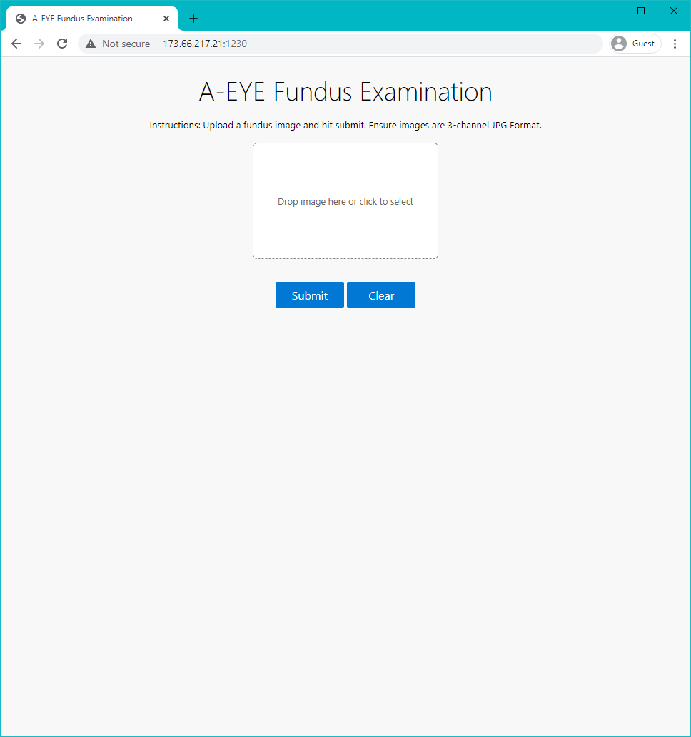
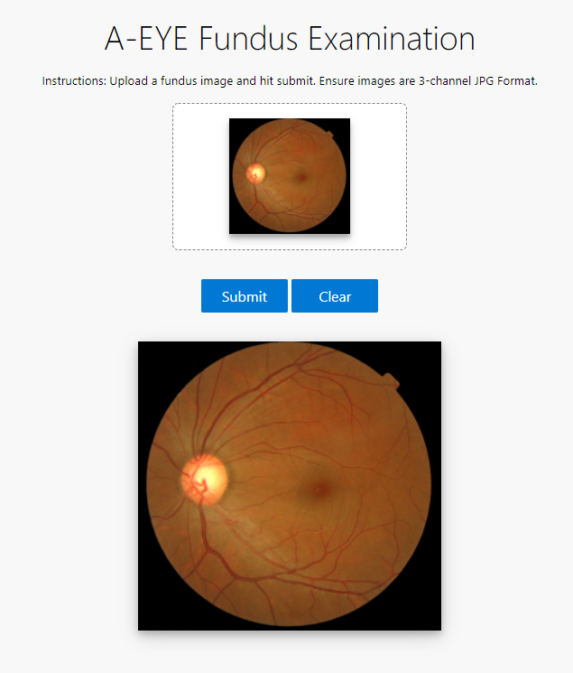
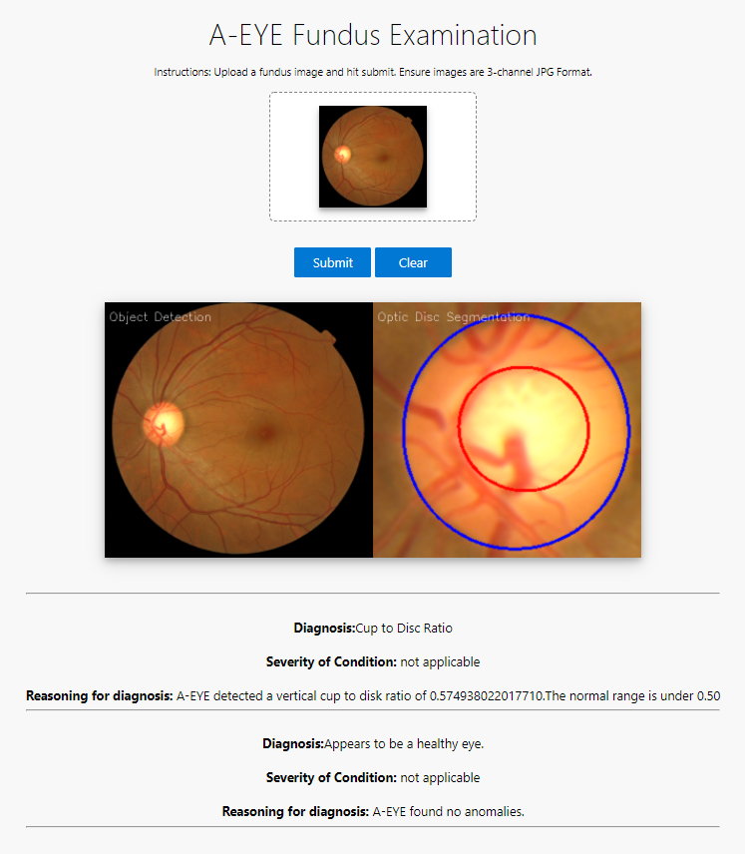
Sample Input/Output of the A-EYE Program
1
2
3
Fundus Image Adapted from the REFUGE Dataset: https://refuge.grand-challenge.org/details/
Website screenshot taken by the finalist; the website was created by the finalist.

Slide 12
References
Abràmoff, M. D., Lou, Y., Erginay, A., Clarida, W., Amelon, R., Folk, J. C., & Niemeijer, M. (2016). Improved Automated Detection of Diabetic Retinopathy on a Publicly Available Dataset Through Integration of Deep Learning. Investigative Ophthalmology & Visual Science, 57(13), 5200. https://doi.org/10.1167/iovs.16-19964
Al-Diri, B., Caliva, F., Chudzik, P., Ometto, G., & Habib, M. (2019). Diabetic retinopathy and maculopathy lesions. In Computational retinal image analysis (pp. 223-243). Elsevier. https://doi.org/10.1016/B978-0-08-102816-2.00012-5
Antal, B., & Hajdu, A. (2012). An ensemble-based system for microaneurysm detection and diabetic retinopathy grading. IEEE Transactions on Biomedical Engineering, 59(6), 1720-1726. https://doi.org/10.1109/TBME.2012.2193126
Fitzgibbon, A. W., & Fisher, R. B. (1995). A buyer's guide to conic fitting. BMVC '95: Proceedings of the 6th British conference on Machine vision, 513-522.
Fu, H., Cheng, J., Xu, Y., Wong, D. W. K., Liu, J., & Cao, X. (2018). Joint Optic Disc and Cup Segmentation Based on Multi-Label Deep Network and Polar Transformation. IEEE Transactions on Medical Imaging, 37(7), 1597-1605. https://doi.org/10.1109/TMI.2018.2791488
Fu, H., Cheng, J., Xu, Y., Zhang, C., Wong, D. W. K., Liu, J., & Cao, X. (2018). Disc-Aware Ensemble Network for Glaucoma Screening From Fundus Image. IEEE Transactions on Medical Imaging, 37(11), 2493-2501. https://doi.org/10.1109/TMI.2018.2837012
Kawasaki, R., & Grauslund, J. (2019). Clinical motivation and the needs for RIA in healthcare. In Computational retinal image analysis (pp. 5-17). Elsevier. https://doi.org/10.1016/B978-0-08-102816-2.00002-2
Layton, O. W. (2019). CS343: Neural Networks [PowerPoint slides]. Retrieved December 30, 2020, from https://cs.colby.edu/courses/F19/cs343/lectures/lecture11/Lecture11Slides.pdf
Mehta, R., & Sivaswamy, J. (2017). M-net: A Convolutional Neural Network for deep brain structure segmentation. IEEE 14th International Symposium on Biomedical Imaging. https://doi.org/10.1109/ISBI.2017.7950555
Nelson, J. (2020, January 26). Why image preprocessing and augmentation matter. Roboflow. https://blog.roboflow.com/why-preprocess-augment
Nguyen, N.-D., Do, T., Ngo, T. D., & Le, D.-D. (2020). An Evaluation of Deep Learning Methods for Small Object Detection. Journal of Electrical and Computer Engineering. https://doi.org/10.1155/2020/3189691
Peking University International Competition on Ocular Disease Intelligent Recognition (ODIR-2019). (2019). Grand Challenge. Retrieved December 30, 2020, from https://odir2019.grand-challenge.org/dataset/&sa=D&ust=1609355270427000&usg=AOvVaw0w8anWctqkz0L_v0oDqFNk
Ramachandran, N., Hong, S. C., Sime, M. J., & Wilson, G. A. (2018). Diabetic retinopathy screening using deep neural networks. Clin Exp Ophthalmol, 46(4), 412-416. https://doi.org/10.1111/ceo.13056
Reza, A. M. (2004). Realization of the Contrast Limited Adaptive Histogram Equalization (CLAHE) for Real-Time Image Enhancement. The Journal of VLSI Signal Processing-Systems for Signal, Image, and Video Technology, 38, 35-44. https://doi.org/10.1023/B:VLSI.0000028532.53893.82
Ronneburger, O., Fischer, P., & Brox, T. (2015). U-Net: Convolutional Networks for Biomedical Image Segmentation. Medical Image Computing and Computer-Assisted Intervention – MICCAI 2015, 234-241. https://doi.org/10.1007/978-3-319-24574-4_28
Setiawan, A. W., Mengko, T. R., Santoso, O. S., & Suksmono, A. B. (n.d.). Color retinal image enhancement using CLAHE. International Conference on ICT for Smart Society, 1-3. https://doi.org/10.1109/ICTSS.2013.6588092
van Grinsven, M. J. J. P., van Ginneken, B., Hoyng, C. B., Theelen, T., & Sanchez, C. I. (2016). Fast Convolutional Neural Network Training Using Selective Data Sampling: Application to Hemorrhage Detection in Color Fundus Images. IEEE Transactions on Medical Imaging, 35(5), 1273-1284. https://doi.org/10.1109/TMI.2016.2526689
World Health Organization. (2019, October 8). World report on vision. https://www.who.int/publications/i/item/world-report-on-vision
Zeiler, M. D., & Fergus, R. (n.d.). Visualizing and understanding convolutional networks. Lecture Notes in Computer Science, 8689. https://doi.org/10.1007/978-3-319-10590-1_53
Zhao, X., Wang, H., & Peng, Z. (2019). Fine segmentation of fundus optic disc based on SLIC superpixel. AI in Optics and Photonics, 11342. https://doi.org/10.1117/12.2547992

